Slide 1
BCSE403L
Digital Image Processing
Digital Assignment - 1
Bracketing Image Restoration
and
Enhancement
Team Members :
Vinthya R R (21BCE5230)
Aditi Padma R P (21BCE1473)

Slide 2
BASE PAPER
Title : NTIRE 2024 Challenge on Bracketing Image Restoration and Enhancement: Datasets, Methods, and Results
Authors : Zhilu Zhang, Shuohao Zhang, Renlong Wu, Wangmeng Zuo, Radu Timofte
Published By : IEEE/CVF Conference on Computer Vision and Pattern Recognition (CVPR) Workshops in 2024
Description :
This paper outlines the NTIRE 2024 Challenge, which aimed to establish benchmarks for multi-exposure, bracketing-based image restoration and enhancement in low-light scenarios. The challenge provided participants with five multi-exposure RAW images for each scene and tasked them with creating noise-free, blur-free, HDR-enhanced outputs, and, in Track 2, even super-resolution outputs. The paper describes the structure of the challenge, its objectives, and the methodologies of the top-performing teams, setting new standards for bracketing image restoration and encouraging further research in multi-image processing techniques​

Slide 3
ABSTRACT
In low-light photography, achieving high-quality image restoration poses significant challenges due to noise, limited detail, and low dynamic range. Bracketing, a technique that captures multiple exposures (underexposed, normal, and overexposed) of the same scene, provides a solution by merging these frames to enhance the overall image quality. This project, inspired by the NTIRE 2024 Challenge on Bracketing Image Restoration, leverages this technique to produce images that are not only clearer but also more dynamic in range. Using a multi-stage restoration pipeline, we aim to achieve state-of-the-art performance in noise reduction, detail enhancement, and HDR processing, providing a promising solution for low-light photography in real-world applications.

Slide 4
MOTIVATION
The demand for high-quality imaging in low-light conditions has grown with applications spanning smartphone photography, surveillance, and autonomous navigation. However, low-light photography often suffers from significant noise, poor contrast, and loss of detail, making it challenging to capture clear images. Traditional single-image techniques attempt to enhance low-light images but struggle to address these issues comprehensively. Bracketing, with its multi-exposure capture technique, offers a way to overcome these limitations. By using images captured at different exposure levels, we can gather a wide range of information, from dark shadows to bright highlights, enabling a more detailed and dynamic final output. This project focuses on exploring advanced bracketing techniques to restore and enhance images, aiming to set new benchmarks for low-light imaging quality.

Slide 5
OBJECTIVES
The project aims to develop a bracketing-based image restoration and enhancement method capable of producing high-quality images in low-light conditions. Specifically, we aim to:
Achieve High-Quality Image Restoration: Minimize noise and enhance clarity, providing sharp, artifact-free images.
HDR and Dynamic Range Enhancement: Use multi-exposure techniques to capture a more extensive range of lighting details, ensuring balanced shadows and highlights.
Real-World Applicability: Develop an efficient processing pipeline that combines quality and speed, making it suitable for real-world applications, especially in mobile and security devices.

Slide 6
PROPOSED METHODOLOGY
The proposed solution for bracketing image restoration and enhancement consists of a multi-stage processing pipeline that integrates cutting-edge techniques in high-low frequency decomposition, alignment, denoising, and HDR reconstruction:
Multi-Stage Pipeline: The solution involves sequential steps for handling alignment, noise reduction, and HDR reconstruction. By breaking down the task, each stage can specialize in refining a particular aspect of the image.
High-Low Frequency Decomposition: This technique divides each image into high-frequency (detail-rich) and low-frequency (overall structure) components, allowing for precise control over noise reduction and detail preservation.
Network Architecture: The proposed model uses a neural network optimized for bracketing image processing, with specific sub-networks for each task. For example, dedicated layers handle denoising, detail retention, and enhancement, working together to produce the final image.

Slide 7
PROPOSED METHODLOGY
Efficiency Focus: Given the potential applications in mobile and real-time imaging, efficiency is a core goal. Techniques like reduced model parameters and optimized GPU operations are planned to ensure high-speed processing without sacrificing quality.

Slide 8
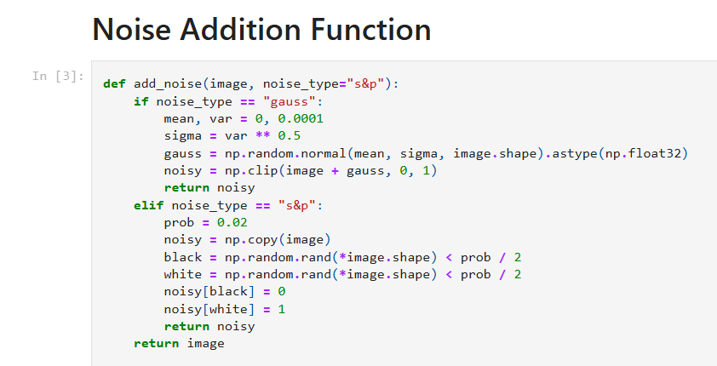
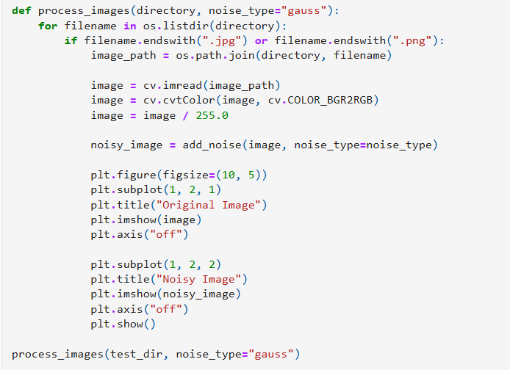
IMPLEMENTATION
1. Preprocessing:
Converts images to normalized RGB values.
Reduces brightness to simulate low-light conditions. Applies noise to the processed images.

Slide 9
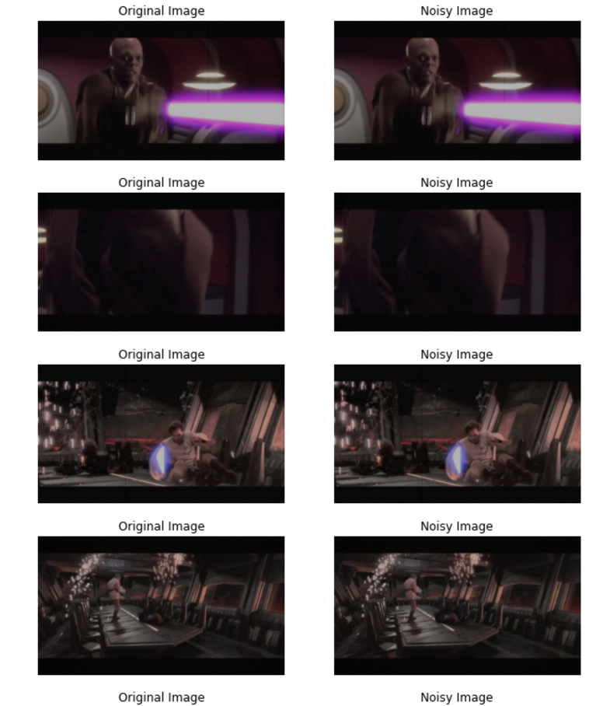
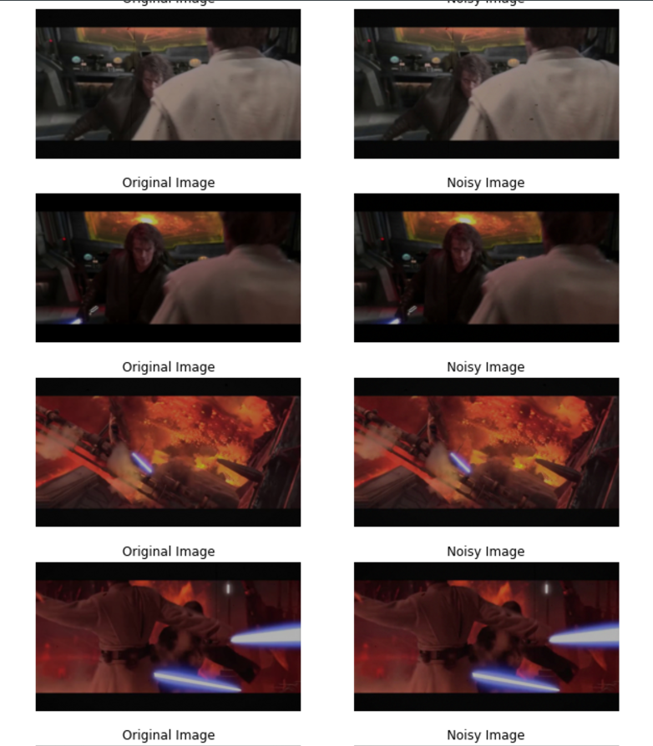
IMPLEMENTATION

Slide 10
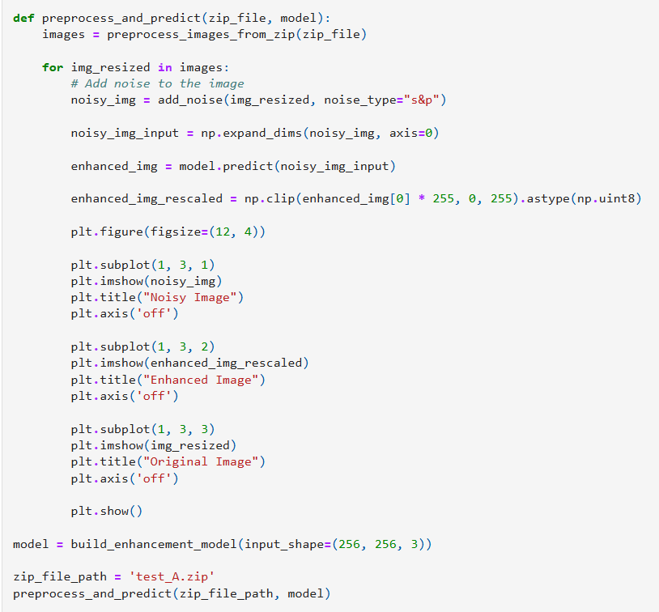
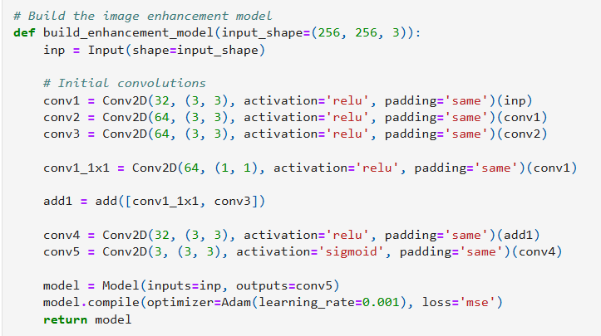
IMPLEMENTATION
2. CNN-Based Image Enhancement:
A custom neural network model restores noisy and low-light images. Uses a combination of convolutional layers and residual connections for enhanced performance.
Visualization:
Compares original, noisy, and restored images side-by-side.

Slide 11
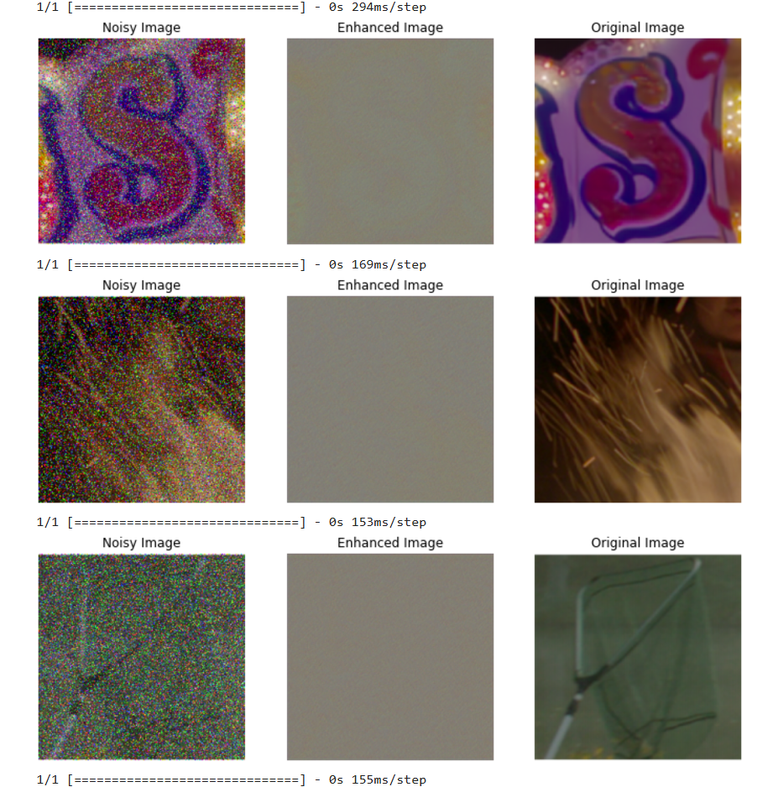
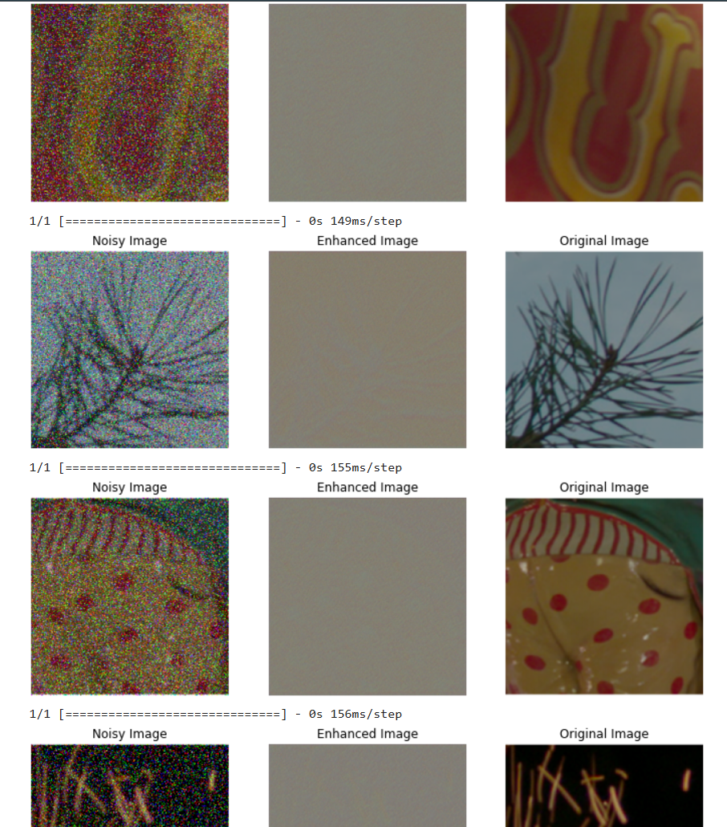
IMPLEMENTATION

Slide 12
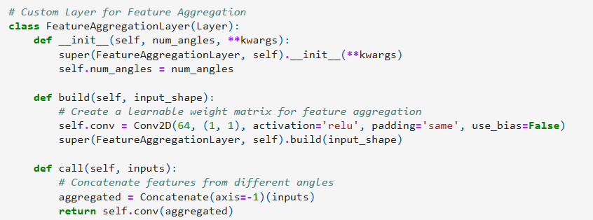
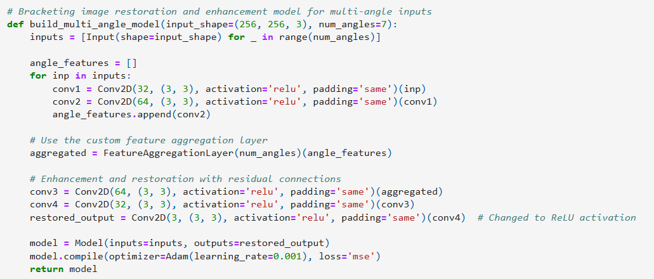
IMPLEMENTATION
3. Model Architecture The image enhancement model consists of:
Multiple convolutional layers with ReLU activation. Residual connections to preserve important features. Final convolutional layer with a sigmoid activation function for output scaling. Loss Function: Mean Squared Error (MSE) Optimizer: Adam (Learning rate: 0.001)

Slide 13
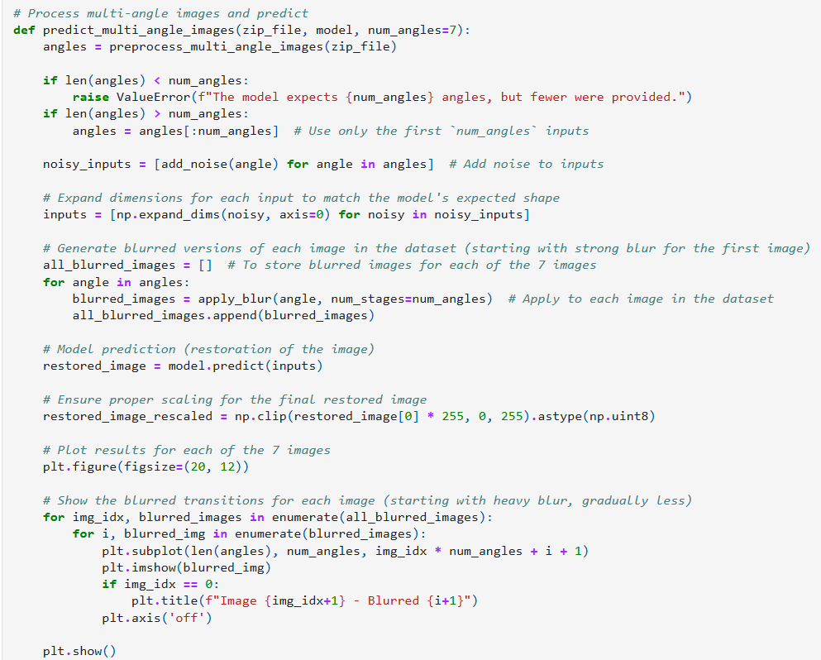
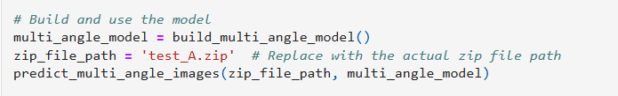
IMPLEMENTATION

Slide 14
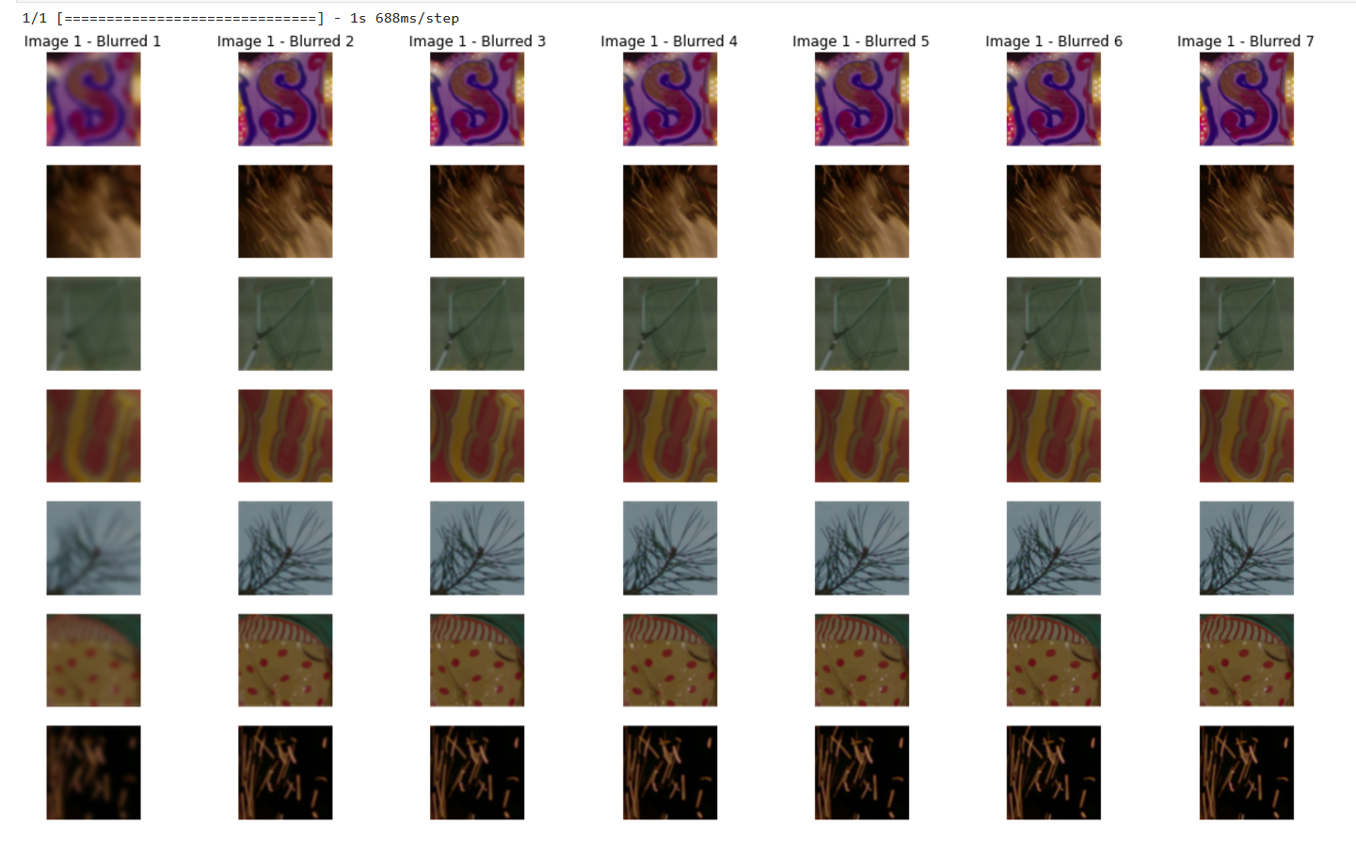
IMPLEMENTATION

Slide 15
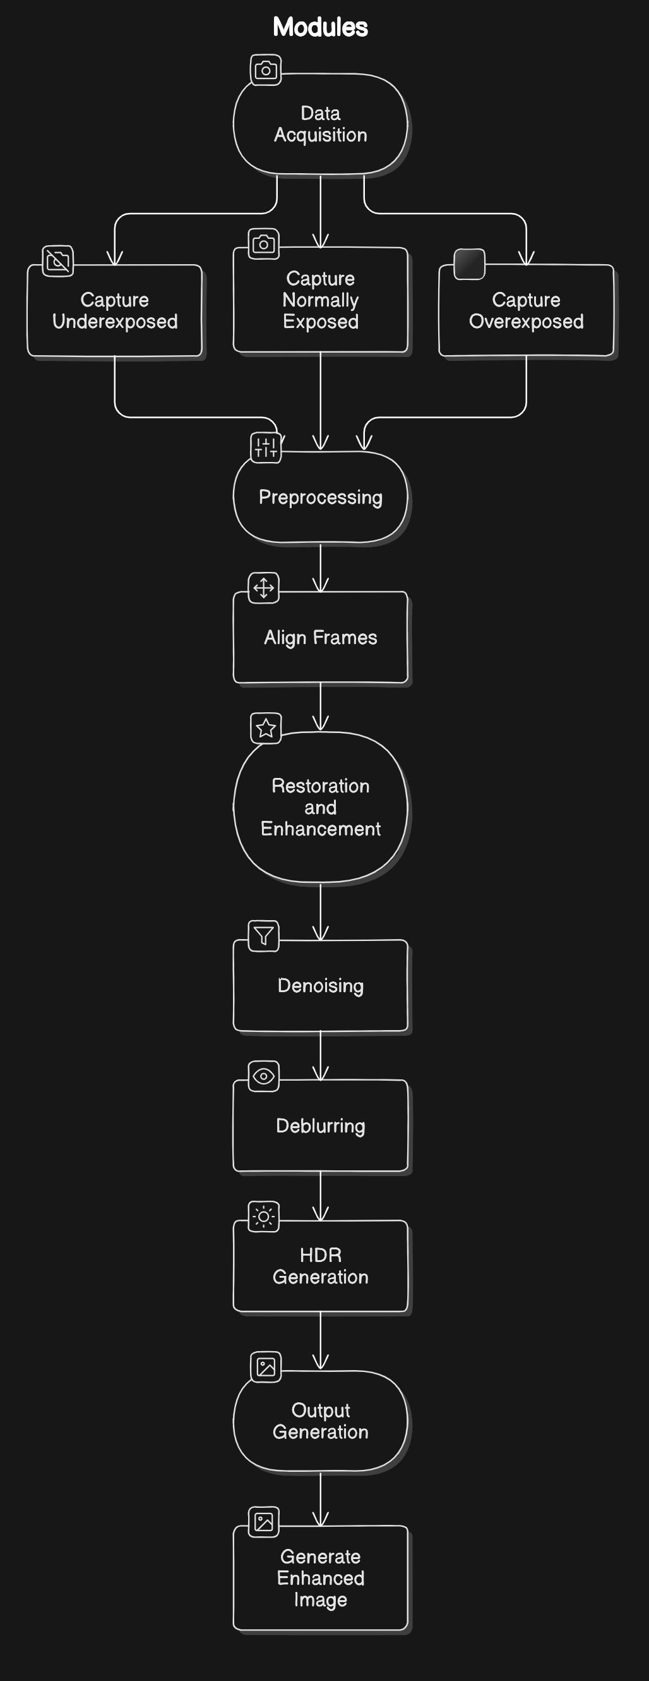
MODULES

Slide 16
CHALLENGES & LIMITATIONS
Computational Intensity: Bracketing requires processing multiple exposures, which increases the computational load. Real-time processing can be challenging with current methods.
Memory Requirements: Handling high-resolution multi-exposure images simultaneously requires significant memory, especially when using advanced neural networks.
Frame Misalignment: Even slight movement between exposures can lead to misalignment, causing artifacts in the merged image. Ensuring accurate alignment is critical yet challenging, especially in real-world, handheld scenarios.
Generalization to Diverse Lighting: While synthetic datasets are used for training, real-world lighting variations can differ greatly, potentially limiting the model's ability to generalize. This could affect performance in diverse conditions like extreme low light or backlighting.

Slide 17
EXPECTED OUTCOMES
The project is expected to yield significant improvements in the quality of images captured in low-light environments:
Enhanced Image Quality: By combining data from multiple exposures, we anticipate a reduction in noise, improved detail, and more balanced contrast, resulting in a clear, visually appealing final image.
Increased HDR and Dynamic Range: The bracketing technique is expected to provide balanced exposures, effectively capturing details in both shadows and highlights and producing HDR-quality results.
Optimized Processing for Practical Use: The final model will be optimized to work efficiently, making it viable for real-world applications such as smartphone cameras, where quick processing is essential.
Benchmark Performance: We expect our model to set new standards for image quality metrics such as PSNR, SSIM, and LPIPS, establishing it as a leading solution in the field of low-light photography.

Slide 18
RESULTS
Input Layer:
The model accepts an input of shape (256, 256, 3), which corresponds to RGB images with dimensions 256x256 pixels.
Convolutional Layers (Conv2D):
Several Conv2D layers are applied sequentially with different filter sizes (32, 64, etc.).
These layers extract spatial features (edges, textures, patterns) from the input image.
Add Layer:
The model includes a residual connection via the Add layer (add_2). This means the output of certain Conv2D layers is added back to another layer, helping to preserve information and prevent vanishing gradients during training.
Restoration:
The final layers restore the processed features back into the original image shape (256, 256, 3).

Slide 19
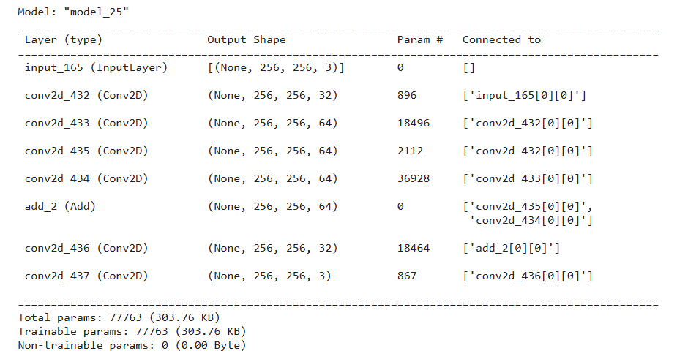
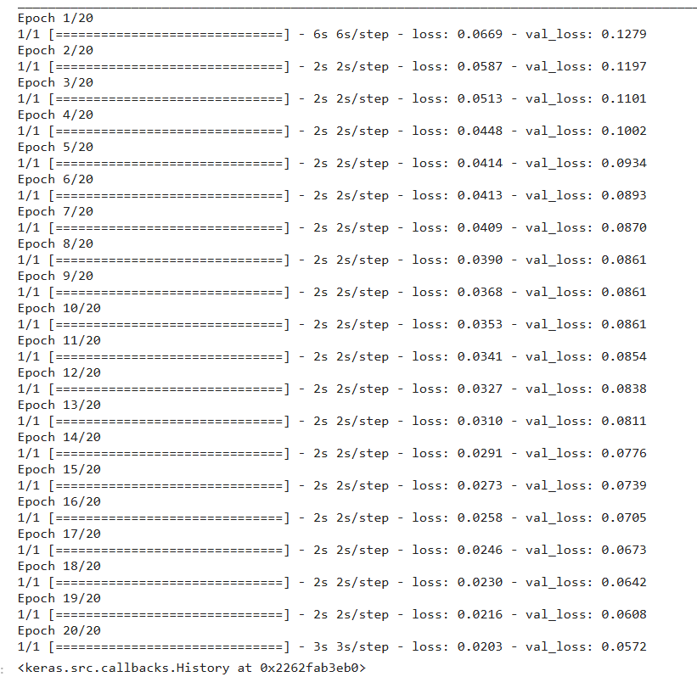
RESULTS

Slide 20
FUTURE WORK
Development of Realistic Datasets: Future iterations of this project will focus on creating datasets that better represent real-world lighting and movement, enhancing model robustness.
Real-Time Bracketing Solutions: By further optimizing the model architecture and using specialized hardware, we aim to develop a solution capable of real-time processing, opening up possibilities for dynamic image enhancement in live scenarios.
Integration with Consumer Devices: The goal is to adapt this technology for integration with mobile cameras and other consumer devices, where real-time, low-light image enhancement is in high demand.
Expanded Restoration Capabilities: Future work will also explore adding features like color correction and adaptive deblurring, further enhancing the model's versatility for varied imaging conditions.

Slide 21
Thank
You

